Slide 1
Naturally Curly
Naturally Curly
Kate Hayes

Slide 2
This is the problem
The global hair industry is worth 90 Billion dollars in 2019¹
Consumers want to know which products are right for their hair
WHY ISN’T THIS EASIER?!?!?!
www.pinterest.com%252Fbebabob73%252F%26psig%3DAOvVaw2Kms6lty88Qh0P872xlCkv%26ust%3D1567655446536827&psig=AOvVaw2Kms6lty88Qh0P872xlCkv&ust=1567655446536827
Notes:
DevaCurl
Jessicurl
Suave
ASIAM
Cantu
Shea
Kinky Curly
Not Your Mothers Naturals
Herbal Essence
Garnier

Slide 3
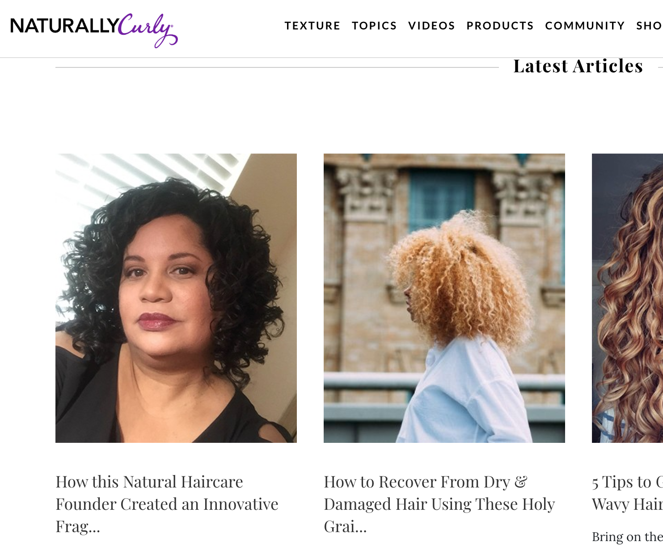

Mission: Be the most trusted & engaging community for women with textured hair.
Founded: September 1998
Offers:
expert content
qualified user-generated product and stylist reviews,
direct digital access to popular products and emerging brands

Slide 4
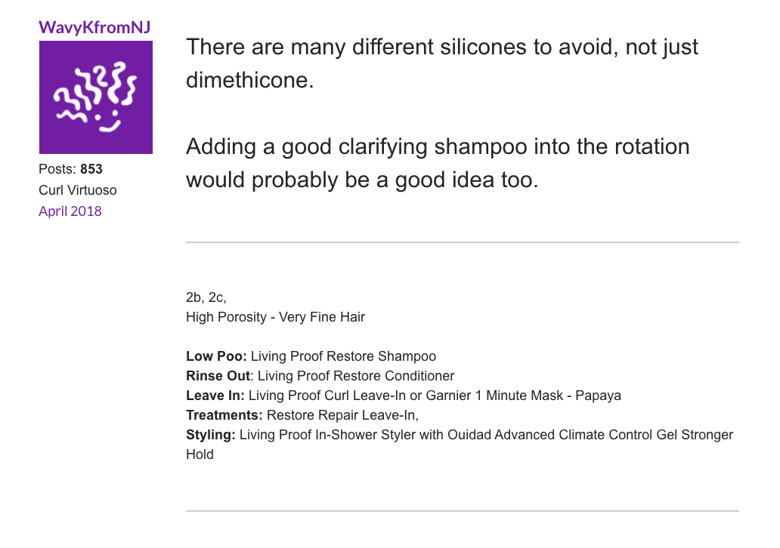
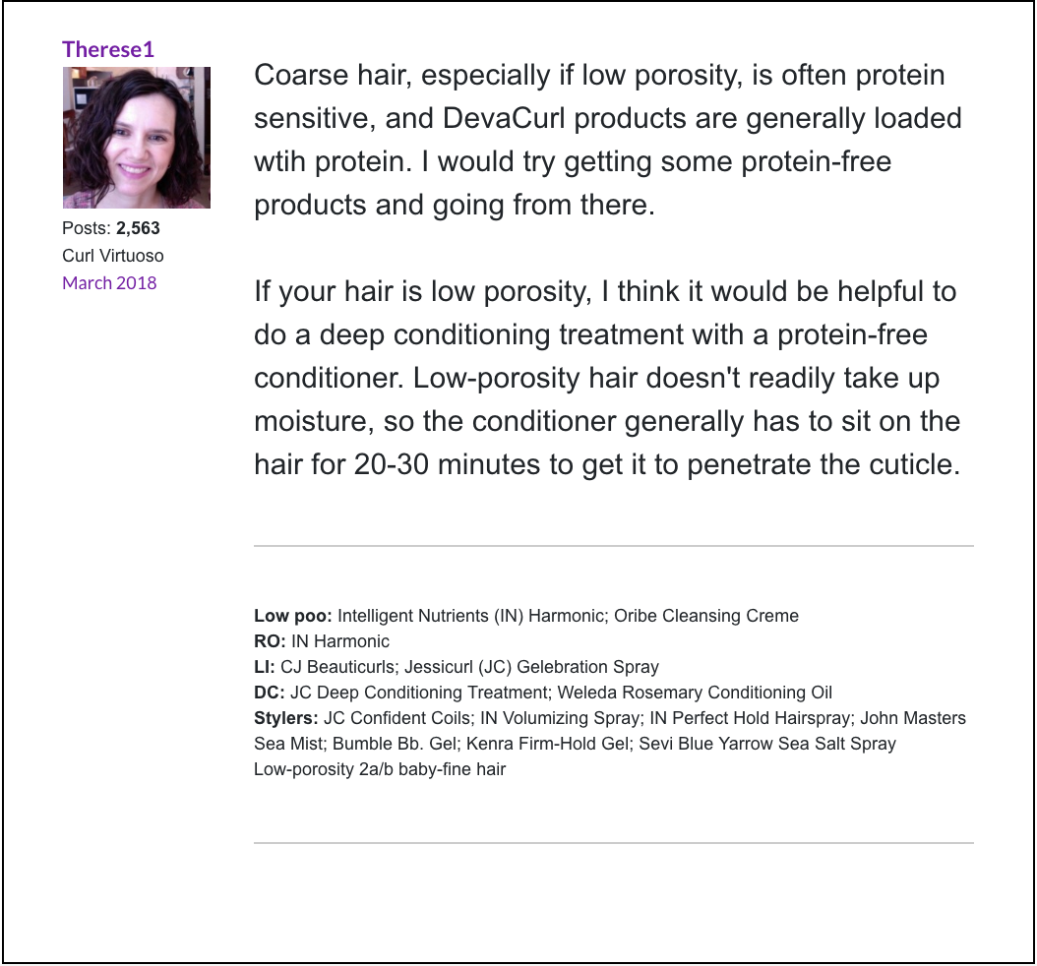
Helpful curly hair community

Slide 5
User forum signatures: hair profiles

Slide 6
User hair profile data
Hair description
Hair products

Slide 7
Hair variables
Curl Pattern
Density
How much scalp is visible
thin, medium, thick
Porosity
How much water your hair holds
Low, normal, high
Texture
How rough is the hair
Fine, medium, coarse

Slide 8
The ultimate dream
Your product drawer
Select current products
How satisfied with this product are you?
Hair data
Select curl pattern
Click to find out your recommended products!!!!
Select hair porosity
Select hair texture
Select hair density

Slide 9
First step – first modeling question
Your product drawer
Select current products
How satisfied with this product are you?
Hair data
How well do people know their hair?
Select curl pattern
Click to find out your recommended products!!!!
Select hair porosity
Select hair texture
Select hair density

Slide 10
But how well do people know their hair?!
Forum Hair Data
Machine Learning
Predict user hair characteristics from their current successful product list
Informed users can then me better decisions abut future products

Slide 11
Modeling challenges
Cleaning text data
“Mix of 3A and 3B” vs “'3b-3c”
Addressing uneven class distributions
(how many are in each class? Show me a brief table)
Creating a product dictionary
Considering context of words, not just pressence

Slide 12
Naturally Curly Forum Signatures
[‘', "Molly didn't want her hair to look pretty- that was out of the question. She only wanted everyone to think she was a clever little girl and not to find fault with her. -George Eliot", "Mix of 3A and 3B\nWash: Recently changed to using low sulfate shampoos. I love it. My hair needs all residue removed to get any volume.\nConditioner: Kinky Curly Knot today\nStyler: AG Recoil (I have eliminated everything but AGRecoil. My hair has tons of volume and bounce.)\nIn high humidity: a dime/nickle size of gel lightly scrunched on the canopy. FINALLY I found a way that doesn't kill my hair volume.", 'password: wavy', '3b-3c, normal porosity\nShampoo: DevaCurl Nopoo \nCondition/Detangle: Giovanni Smooth As Silk \nLeave-in: the Giovanni or Mixed Chicks\nOnly When Needed: Jojoba Oil, ACV wash\n\n"If you want your life to change, you have to change some things in your life.":tongue3:\n']

Slide 13
Approach
Heavy usage of regular expressions to clean the data up
Label and remove the four characteristics from each signature if present
Inspect various Ngrams for possible products
Perform TF-IDF on the products and use that as the feature and try to predict each characteristic category in return

Slide 14
Results
Models Used:
LinearSVC
LogisticRegression
MultinomialNB
RandomForestClassifier
Logistic Regression consistently outperforms other models and Multinomial Naïve Bayes is a close second
Texture was classified with about 74 % accuracy
Density was classified with about 58 % accuracy
Porosity was classified with about 45 % accuracy
Curl Pattern was classified with about 32 % accuracy

Slide 15
Conclusions & Future Work
All models for each characteristic that was attempting to be predicted performed better than random guessing
The product predictor text needs to be cleaned up more and non-relevant signatures discarded as well as all common acronyms
Upsampling or downsampling needs to be applied to even out class imbalances
Different scoring metrics can be examined as well for different insights into the data

Slide 16
Thank You For Your Time
Questions?

